Slide 1
Market report on brewery
A Statistic Analysis of Beer & Brewery Data

Slide 2
Breweries per State
AK | 7 | GA | 7 | MD | 7 | NH | 3 | SC | 4
AL | 3 | HI | 4 | ME | 9 | NJ | 3 | SD | 1
AR | 2 | IA | 5 | MI | 32 | NM | 4 | TN | 3
AZ | 11 | ID | 5 | MN | 12 | NV | 2 | TX | 28
CA | 39 | IL | 18 | MO | 9 | NY | 16 | UT | 4
CO | 47 | IN | 22 | MS | 2 | OH | 15 | VA | 16
CT | 8 | KS | 3 | MT | 9 | OK | 6 | VT | 10
DC | 1 | KY | 4 | NC | 19 | OR | 29 | WA | 23
DE | 2 | LA | 5 | ND | 1 | PA | 25 | WI | 20
FL | 15 | MA | 23 | NE | 5 | RI | 5 | WV | 1
 |  |  |  |  |  |  |  | WY | 4

Slide 3
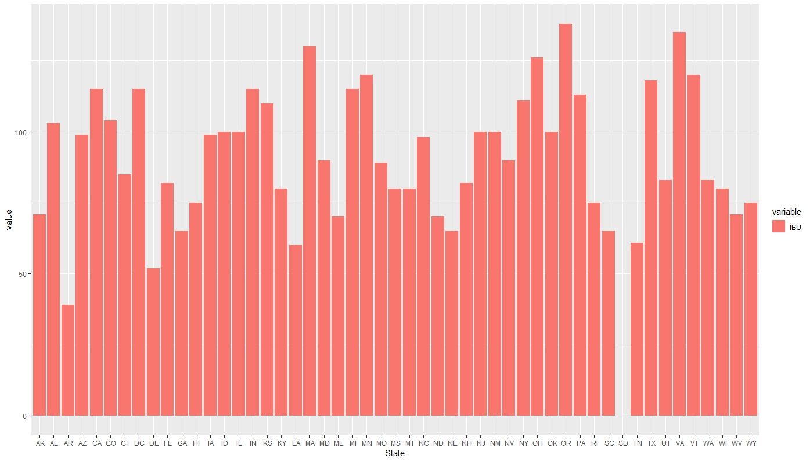
Median IBU per state

Slide 4
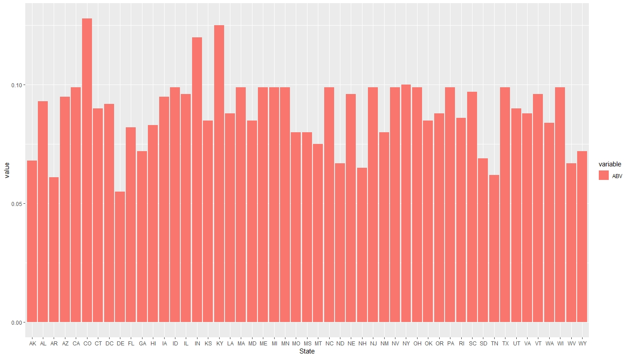
Median ABV per state

Slide 5
max abv and ibu state
 | STATE | VALUE
MAX ABV | Colorado | ABV=0.128
MAX IBU | Oregon | IBU=138

Slide 6
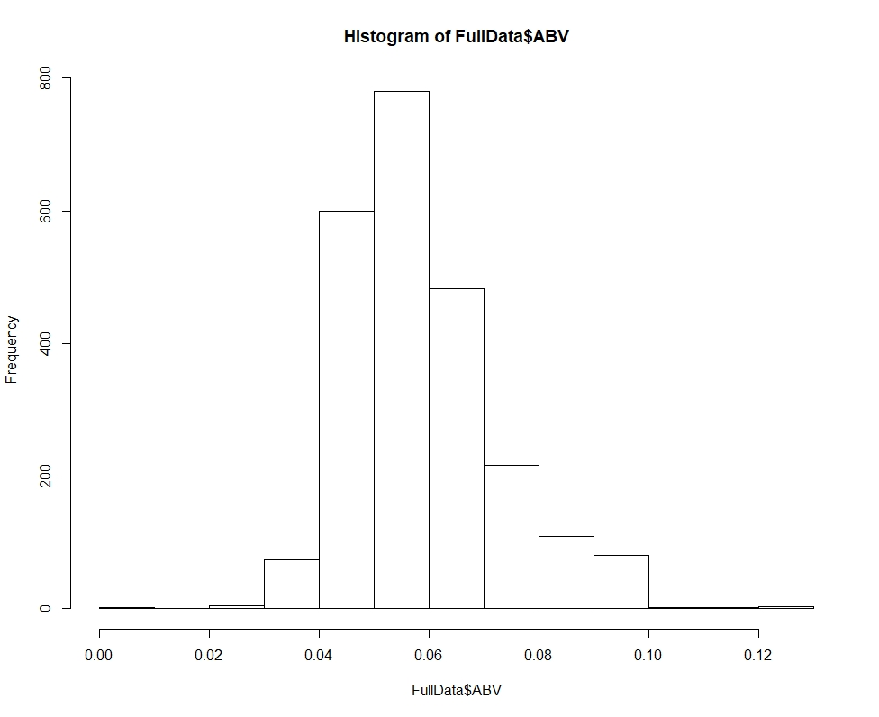
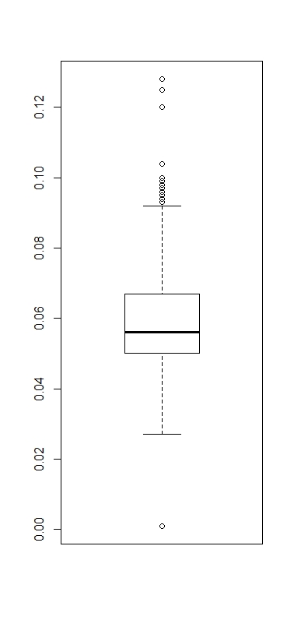
ABV summary statistics
Colorado has the most alcoholic beer across all states.
MIN | 1ST QU. | MEDIAN | MEAN | 3RD QU. | MAX
0.001 | 0.05 | 0.056 | 0.05977 | 0.067 | 0.128

Slide 7
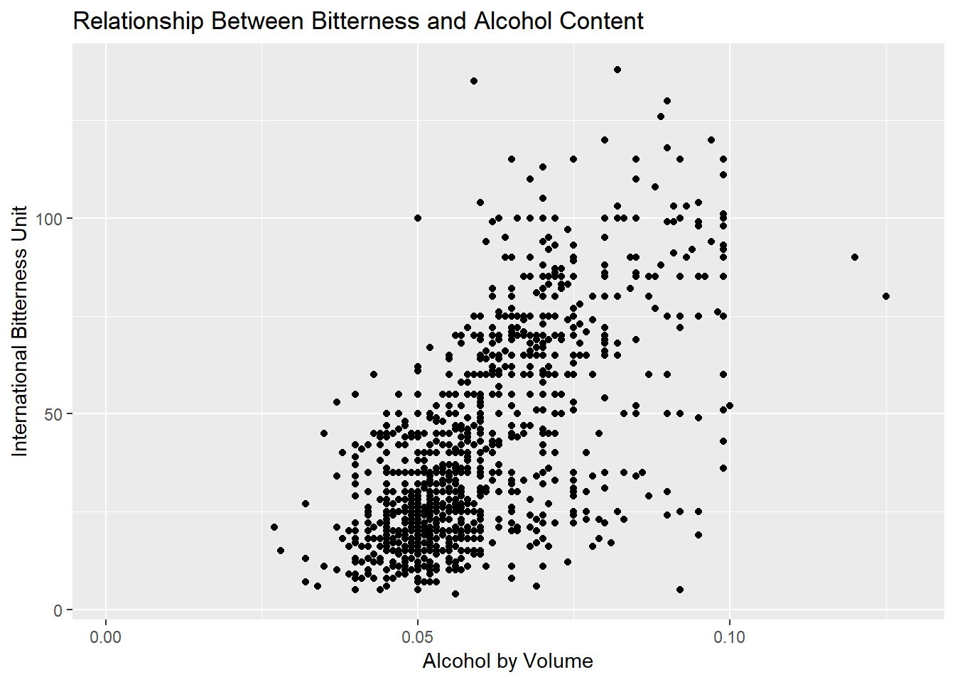
Bitterness & alcoholic content
Scatter Plot shows:
Lower IBU tends to have more lower ABV
Higher IBU tends to have higher ABV
Lower IBU and ABV beers has more samples

Slide 8
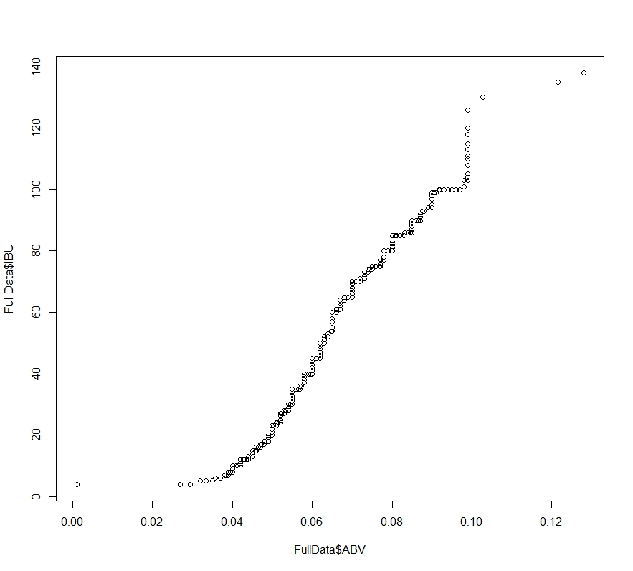
Bitterness & alcoholic content
Further qq-plot shows IBU and ABV has a close to linear relationship.

Slide 9
conclusions
The current market has more brand lower bitterness and alcoholic beer.
It shows consumers in domestic market over all prefer such beer flavor.
Colorado state has the max alcoholic beer USA
Oregon state has the most bitter beer in USA

